Slide 1




Notes:
What I will talk about may be a bigger picture: the nationwide AI.
Earlier this year, the UK government has announced plans to invest millions of pounds of government funding to develop AI that is able to diagnose cancer and chronic disease before symptoms have developed, potentially saving 20,000 lives each year.
AI is increasingly being heralded as a technology to achieve further breakthroughs in the sector – including the potential to detect cancer.

Slide 2
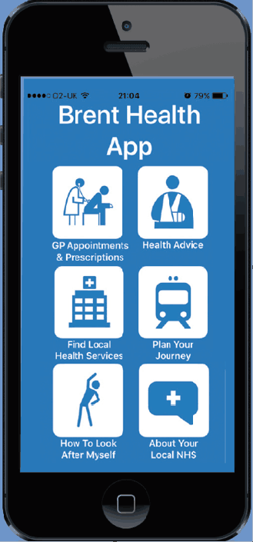
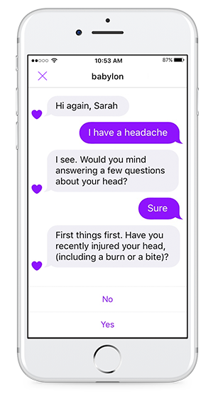
Notes:
However, faced with a growing population and tight budget, NHS has already started looking to AI to improve patient service and cut costs. With smartphones due to become the primary method of accessing health services, the NHS is already investing in AI-powered apps and implementing technology which will allow NHS 111 enquiries to be handled by robots within two years.
~50s

Slide 3
People’s opinion
--Figures come from OpenText
Notes:
Yet recent research by OpenText has revealed widespread uncertainty amongst the UK population when it comes to trusting their health to AI:
As the first graph depicts, although a more accurate diagnosis was identified as the biggest benefit of introducing AI into healthcare, yet only a quarter (26%) of UK consumers believe robots would reach the correct diagnosis
The second chart revealed that 41% do not know if they would trust the medical diagnosis given by AI and a further 26% confirmed that they did not trust the technology. Just 11% said they would trust the diagnosis of AI
However, as for the major benefits of AI technology– 21% believe it can offer a quick diagnosis and the same proportion (21%) would appreciate not having to take time off work to visit a doctor
So we can see many people worry about the accuracy problem but still wish to use the technology if it gets more accurate
~1min 50s

Slide 4


Accuracy
Current treatment
precision medicine
Notes:
So the accuracy is really a barrier at present
Accuracy
current situation may look like this: You see the players pass from one to another… it just looks like patients referring to many doctors and try different advice but probably there will not be a good outcome
(I know exactly the kind of AI treatment that most people want) It looks like this
precision medicine: it just looks like Maguire's perfect head goal right into the corner
We need our machine to be this smart and give us the very prescription that will solve our problem

Slide 5
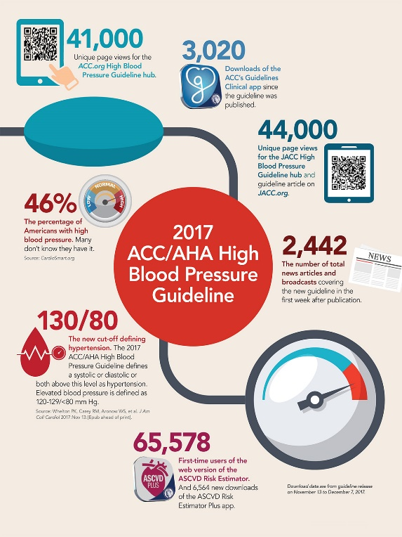
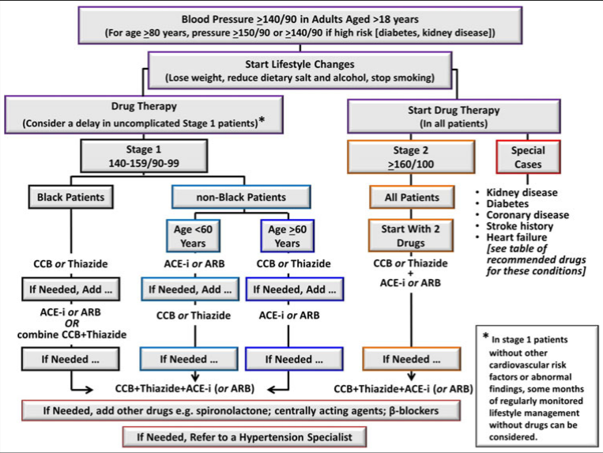
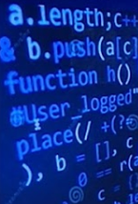

Knowledge
Guidelines
Clinical methodology
Medical system
Notes:
But HOW can we improve the accuracy? As we all know, what we reckon a good doctor may either have a considerable amount of knowledge or have much richer experience than others. So is our medical system. If we want our machine to be smarter, we need to train it from knowledge and experience.
We all know there is so much knowledge that we need to memorize in the learning process. For doctors, they need to memorize the physiology, pathology, Pharmacology, Genetics, Statistics… so many things and so difficult. But the machine does better in this, yep, memorizing, by feeding more knowledge and guidelines to the machine and changing the words that we know into the code that the machine knows, it can reach the same level like our professional doctors easily

Slide 6
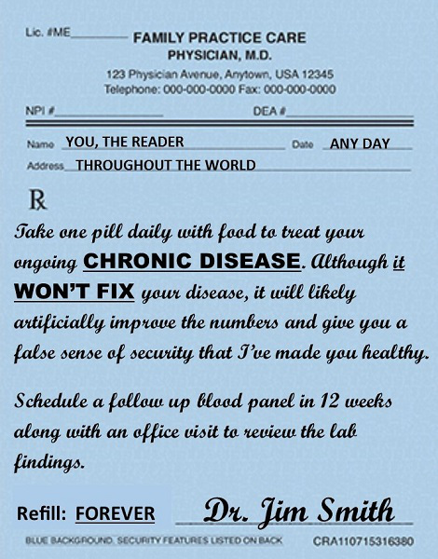
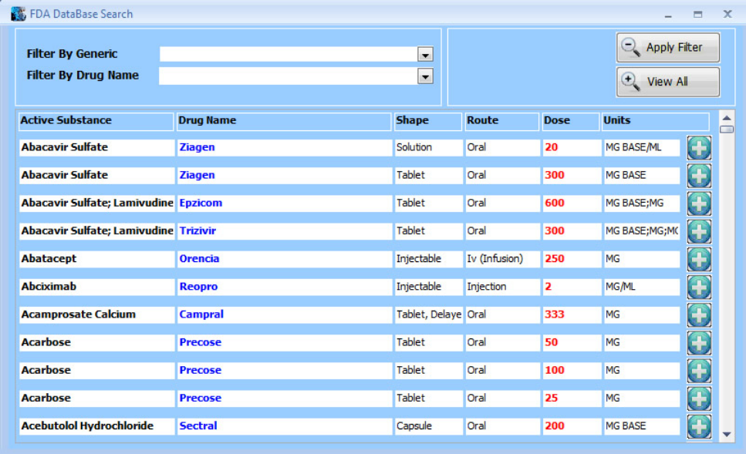
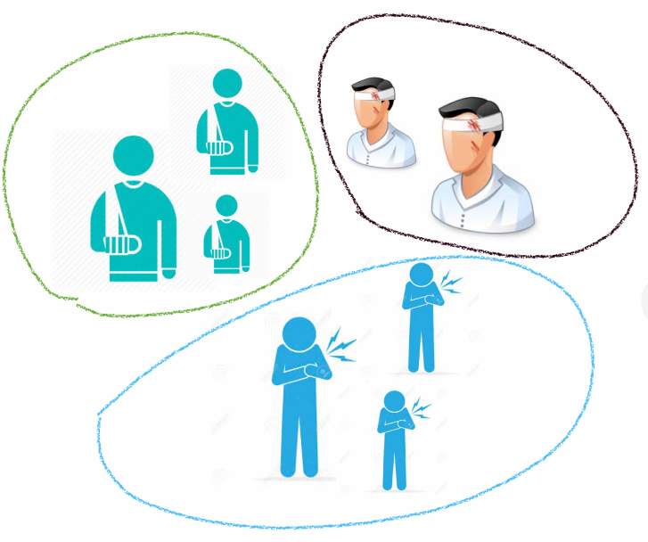
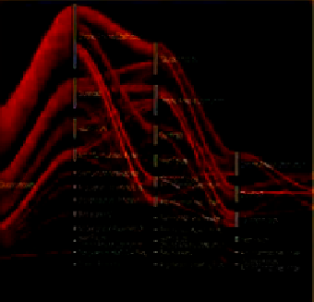
Experience
Medical records
dataset
Similar patients
Best approach
Notes:
The other is experience. Several months ago, Theresa May has challenged health charities, the NHS and the AI sector to pool data in order to transform the diagnosis of chronic diseases. Medical records, along with information about patients’ habits and genetics, will be cross-referenced with national data to spot those at an early stage of cancer.
That’s good news.
By transforming non-structural data in the medical records like prescription into large structural dataset, the machine can extract useful information and get much richer experience. Next time we come to AI for help, the system can find you thousands of similar patients in your case, and will check the best outcome automatically and return the best approach for you within a minute.

Slide 7
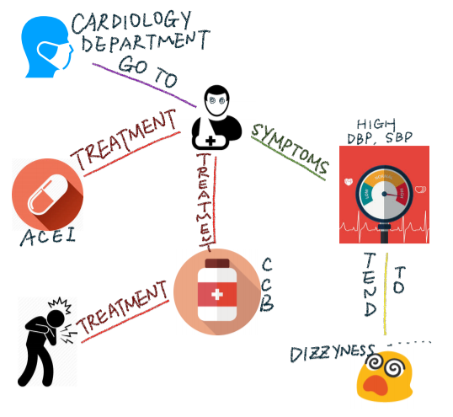
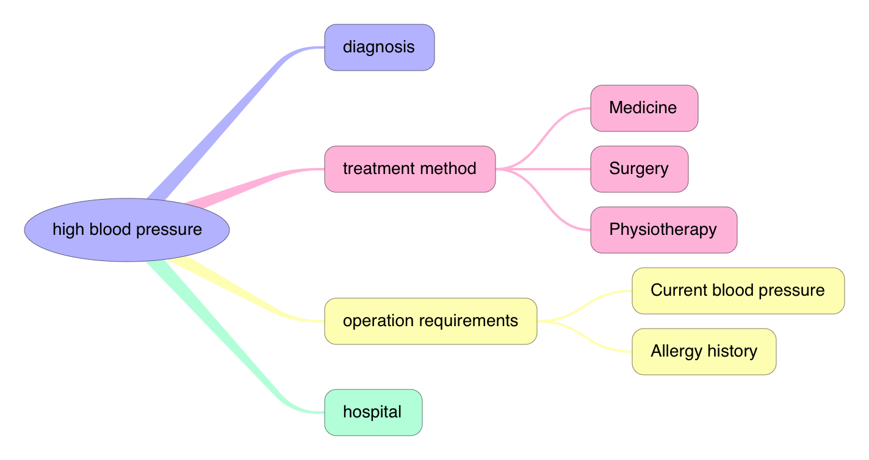
Education
ask
teach
Knowledge Graph
User’s question
Notes:
But a more practical use may be this one. We know nowadays there are so many patients who have no clue how to treat their disease.
One solution is that we can feed the common questions of patients to the machine and improve the knowledge graph in it. In turn, the machine can enhance the patients’ idea about their disease, like answering the questions.
Although AI has carried so much hope, it cannot replace the human in the entire diagnostic process in the short term. but it can enable automation of mundane tasks, allowing specialist staff to be alerted to the more complex cases that require their attention. It is reassuring to see the government’s commitment to this crucial area, that could do so much to reduce the ever growing pressure on NHS diagnostic departments.

